Slide 1
Hindi to English: Transformer-Based Neural Machine Translation
Authors:
Kavit Gangar
Hardik Ruparel
Shreyas Lele

Slide 2
Agenda
Introduction
Literature Survey
Transformer Model
Results
Conclusion

Slide 3
Introduction
Machine translation is one of the oldest tasks taken up by computer scientists and the development in this field has been going on for more than 60 years
Rule Based Machine Translation (RBMT) is a system based on linguistic information about the source and target languages derived from dictionaries and grammar including semantics and syntactic regularities of each language
Statistical Machine Translation (SMT) approaches leverage probability and statistics to determine the output sequence instead of having rules determine the target sequence. This approach made it feasible to cover all types of language within the source and target language and to add new pairs

Slide 4
Introduction
The development of various deep learning techniques and the promising results shown by the combination of these techniques with NLP created a new approach called Neural Machine Translation (NMT).
NMT is a simple Deep Neural Network (DNN) that reads the entire source sentence and produces an output translation one word at a time.
NMT’s advantage lies in two facts that are its simplistic architecture and its ability to capture long dependencies in the sentence, thereby indicating its huge potential in emerging as a new trend of the mainstream

Slide 5
Literature Survey
The early Multilayer Perceptron neural network models had been greatly improved upon through the use of recurrent neural networks organized into an encoder-decoder architecture that allow for variable length input and output sequences.
Encoder-Decoder architecture has problems with long sequences of text to be translated which is solved by using an attention mechanism that allows the model to learn where to place attention on the input sequence as each word of the output sequence is decoded.
Although effective, these systems still suffer from some issues such as scaling to larger vocabularies of words and the slow speed of training the models.

Slide 6
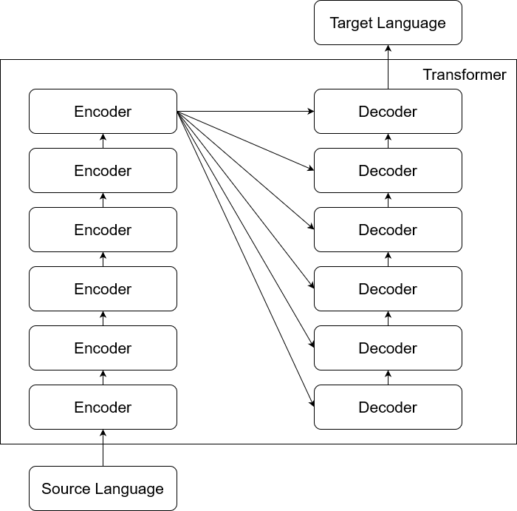
Transformer : Architecture

Slide 7
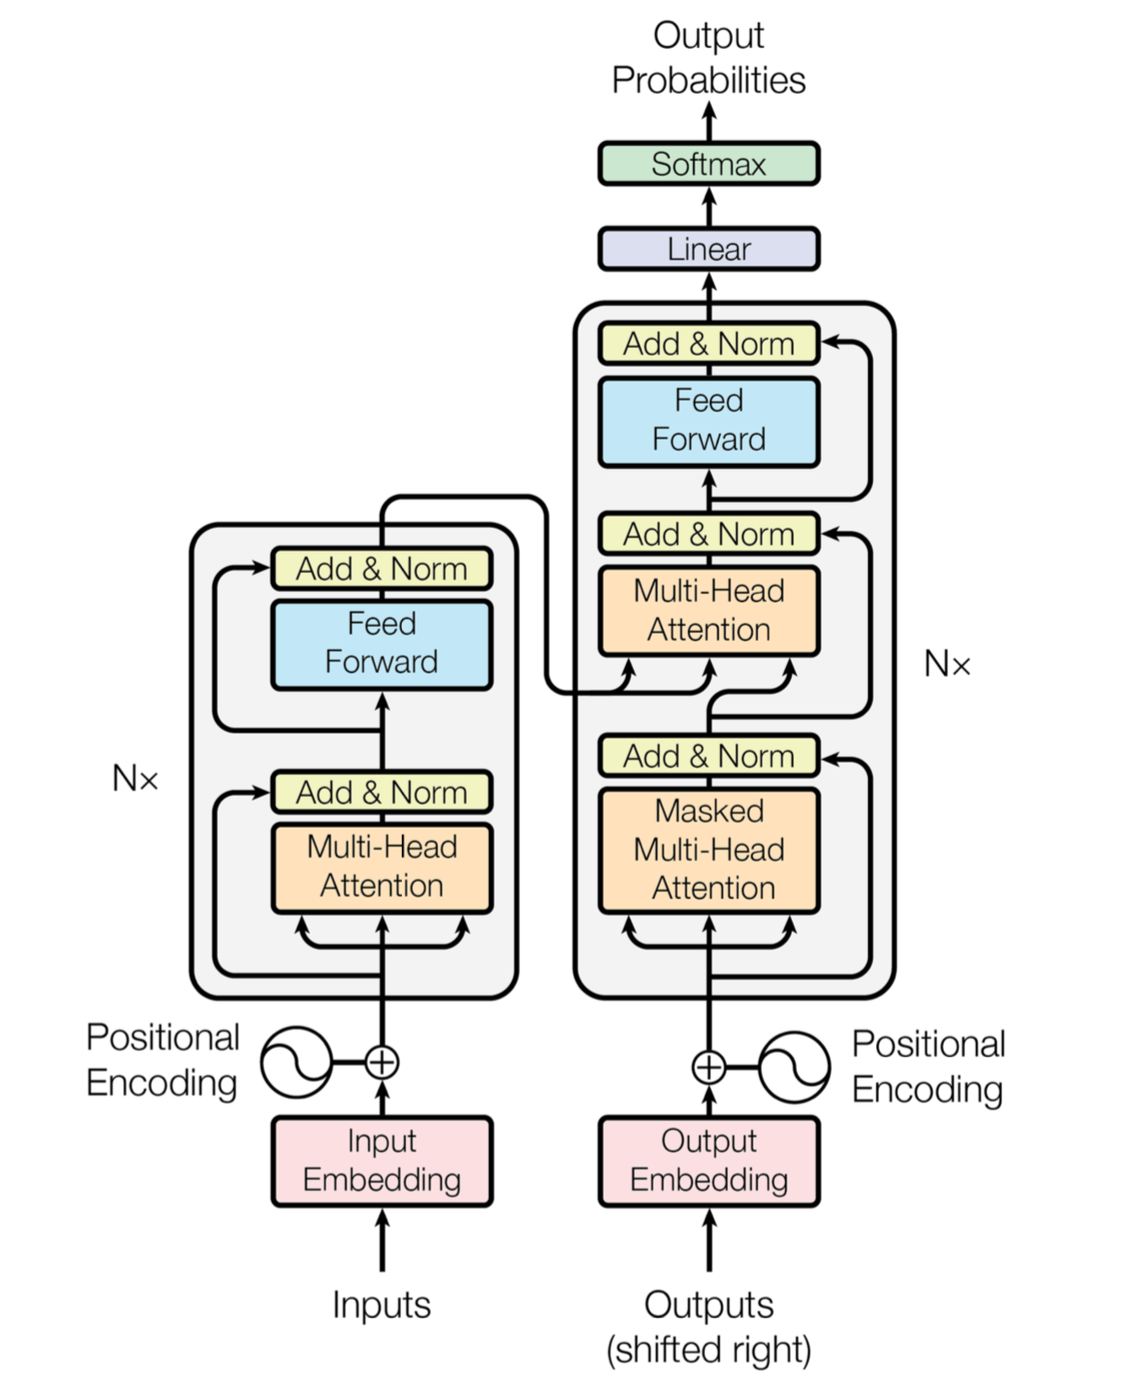
Transformer : Working

Slide 8
Transformer : Working

Slide 9
Byte Pair Encoding & Back Translation
Byte Pair Encoding (BPE) divides the words such that the frequent sequence of letters is combined to form a root word and affix.
BPE helps solve the OOV words by merging the root word with different combination of affixes.
e.g: Nevada -> Ne@@ vada
Back Translation is used to augment the training data to compensate for low availability of the source language.
This technique allows the Machine Learning models to enhance its context-base thereby improving the accuracy of the translations.

Slide 10
Dataset
Data - Hindi-English parallel corpus by the Center for Indian Language Technology (CFILT), IIT Bombay
For back-translation, we used the 3 million WMT14 English monolingual data to generate the corresponding predicted Hindi text corpus.
Dataset | # of Sentences | Unique Hindi Words | Unique English Words
Train | 1,267,502 | 421,050 | 242,910
Dev | 486 | 2,479 | 2,405
Test | 2,478 | 8,428 | 9,293
Batch Number | # of Back-translated records added | Total Records
Batch 1 | 0.5million | 1.7million
Batch 2 | 1.5million | 2.7million
Batch 3 | 2.5million | 3.7million
Batch 4 | 3million | 4.2million

Slide 11
Results
Set-1 consists of 1694 sentences whose words are present in the vocabulary generated from word level tokenization.
Word level tokenization on set-1
Sub-word level tokenization on set-1
Model | BLEU | RIBES
Transformer | 18.76 | 0.699708
Transformer + B1 | 22.55 | 0.730440
Transformer + B2 | 23.95 | 0.735804
Transformer + B3 | 24.79 | 0.741369
Transformer + B4 | 24.68 | 0.740567
Model | BLEU | RIBES
Transformer | 19.10 | 0.695566
Transformer + B1 | 23.98 | 0.733614
Transformer + B2 | 25.44 | 0.737078
Transformer + B3 | 25.87 | 0.739192
Transformer + B4 | 25.74 | 0.742397
*The Bilingual Evaluation Understudy Score or BLEU and Rank-based Intuitive Bilingual Evaluation Score or RIBES, are metrics for evaluating a generated sentence to a reference sentence.

Slide 12
Results
Set-2 consists of the complete test set consisting of 2478 sentences
Results for the Transformer with Batch4 model on Set-2
Tokenization | BLEU | RIBES
Word level | 21.22 | 0.728683
Sub-word level | 24.53 | 0.735781
The decrease in the BLEU and RIBES score as compared to Table 3 and Table 4 is due to the fact that the Set-2 consists of additional sentences as compared to Set-1 which contain rare words that are not included in the vocabulary for word level tokenization.
When sub-word level tokenization is used, the model performs reasonably well even in the presence of rare words which is not the case for word level tokenization.

Slide 13
Conclusion
The transformer model has displayed promising results for neural machine translation involving low resource languages as well.
After adding the back-translated records the performance certainly improved, however when the amount of generated data increases beyond a certain level, there is no further improvement in the performance.
Using a combination of the transformer model, back-translation technique and a sub-word tokenization method like BPE, we achieved a BLEU score of 24.53 which is the state-of-the-art on this dataset to the best of our knowledge.

Slide 14
Thank You
Authors:
kavitgangar34@gmail.com
hardikruparel14@gmail.com
shreyaslele2398@gmail.com

